Slide 1
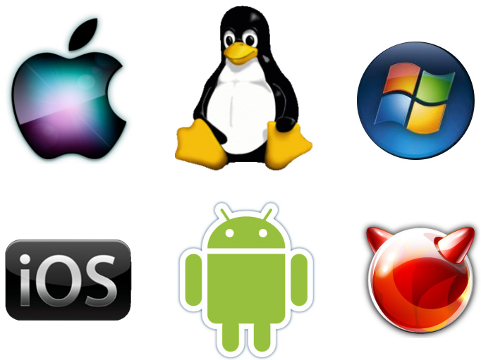
Operating System (O.S)
Lect-3

Slide 2
Some OS Tasks
Program Execution
An OS has to be able to load a program into memory and run that program. Also, this program needs to be able to end execution, whether normally or abnormally.
I/O Operations
A running program may require I/O in the form of a file or an output device.
Due to a security or efficiency need, users often do not control I/O, so the OS must provide the means for I/O.
File-system manipulation
Programs need to able to read and write to files, also delete, rename, and remove them.
It is also necessary that files have permission functionality to provide additional security.

Slide 3
OS Tasks
Communication
Often times one process must communication with another process.
Communication may be between the processes of a single computer, or computers connected via a network.
Communication may be implemented via shared memory or through message passing.
Error detection
An OS should be constantly looking for errors, and know how to handle them.
For each error, the OS should have an action to take to ensure correct and consistent computing.
Debugging facilities enhance user and development usage of the system.

Slide 4
OS Efficiency Functions
Resource Allocation
Multiple users or jobs require that resources be allocated to each one.
Some resources have a special allocation code, while others may have more general request and release code.
Protection and Security
It should not be possible for one process to interfere with other processes or the OS itself.
This means that all access to system resources is controlled.
Protecting the system from outside threats is done through authenticating users, and to defending external I/O devices.
Log files can help detect and track attempts of outside infiltration.

Slide 5
The operating system from two view points:
User View
System View

Slide 6
User view
Users view varies according to interface used.
Some operating systems are designed for ease of use with some attention paid to performance and none paid to resource allocation.
These systems are designed for the single-user experience.
Some operating systems are designed to maximize resource utilization to assure that all available CPU time, memory, and I/O are used efficiently and no individual user takes more than his share.
These are multi-user systems where terminals are connected to mainframe or minicomputers.
users share resources and may exchange information.
In some cases users sit at workstations connected to networks of other workstations and servers.
These systems have dedicated resources such as networking and servers.
These operating systems compromise between individual usability and resource utilization.

Slide 7
System View
The program that is most intimately involved with the hardware.
The operating system is a resource allocator.
The following resources may be required to solve a problem:
CPU time
memory space
file-storage space
I/O devices etc.
The operating system acts as the manager of these resources.

Slide 8
System Boot
Booting the system is done by loading the kernel into main memory, and starting its execution.
The CPU is given a reset event, and the instruction register is loaded with a predefined memory location, where execution starts.
The initial bootstrap program is found in the BIOS read-only memory.
This program can run diagnostics, initialize all components of the system, loads and starts the Operating System loader. (Called boot strapping)
The loader program loads and starts the operating system.
When the Operating system starts, it sets up needed data structures in memory, sets several registers in the CPU, and then creates and starts the first user level program. From this point, the operating system only runs in response to interrupts.
Boot Strap program: A simple initial program that run when computer power up and transfer control to operating System

Slide 9
Spooling
Spooling is an acronym for simultaneous peripheral operations on line. Spooling refers to putting data of various I/O jobs in a buffer. This buffer is a special area in memory or hard disk which is accessible to I/O devices. Operating system does the following activities related to distributed environment.
OS handles I/O device data spooling as devices have different data access rates.
OS maintains the spooling buffer which provides a waiting station where data can rest while the slower device catches up.
OS maintains parallel computation because of spooling process as a computer can perform I/O in parallel fashion. It becomes possible to have the computer read data from a tape, write data to disk and to write out to a tape printer while it is doing its computing task.

Slide 10
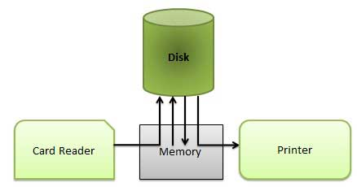
Advantages
The spooling operation uses a disk as a very large buffer.
Spooling is capable of overlapping I/O operation for one job with processor operations for another job.

Slide 11
Operating System Properties

Slide 12
Properties of O.S (Assignment)
Operating systems are there from the very first computer generation. Operating systems keep evolving over the period of time. Following are few of the important types of operating system which are most commonly used.
Properties of O.S
Batch Processing
Multi Programming
Multi
Processing
Multi Tasking

